Slide 1

AGRO-BOT
Weed Removal and Plant Monitoring Robot
Group Members:
Saud Ahmed (202576)
AbdurRehman Naeem (2021294)
Ali Ahmed Mir (2021075)
Shahid Ahmad (2021xxx)
Advisor:
Dr. Muhammad Hanif
Co-Advisor:
Dr. Taimur

Slide 2

Project Overview:
Problem Statement:
Weeds significantly reduce agricultural productivity by competing with crops for essential resources such as water, nutrients, and sunlight. This competition can lead to yield losses of up to 30% in some crops. Limitations of Traditional Methods:
Inefficient: Manual labor and herbicide use are time-consuming.
Costly: Traditional methods incur high labor and chemical costs.
Environmental Harm: Herbicides can negatively affect ecosystems and soil health.

Slide 3
Project Overview:
Aims/Proposed Solution:
Develop an autonomous, solar-powered robot for weed detection and removal.
Utilize laser technology for precise weed elimination.
Incorporate real-time plant monitoring to enhance agricultural practices.

Slide 4
Project Overview:
Goals/Objectives:
Improve farming efficiency.
Reduce reliance on harmful chemicals.
Promote sustainable agriculture.

Slide 5

Motivation
Agriculture is crucial for Pakistan's economy, employing 40% of the workforce and contributing 20% to GDP.
Weeds reduce crop yields by competing for vital resources, causing significant economic losses.
Current weed management relies on manual labor and harmful herbicides.
Our AI-based weed removal robot offers an automated, eco-friendly solution using laser technology.
This innovation can improve yields, reduce costs, and promote sustainable farming in Pakistan.

Slide 6

Literature Review
Existing Systems
Traditional weeding methods.
Robotic weeding systems (limited functionalities i.e Ecorobotix and Naio technologies).
Plant monitoring systems (standalone, not integrated with weeding e.g FarmBot and OpenAg Initiative).

Slide 7
Literature Review
Novelty in Our Project
Integrated system combining weeding, autonomous navigation, and plant monitoring
Use of solar power for sustainability
Variable size and waterproof design for different agricultural environments

Slide 8
Literature Review
Research Paper | Authors | Literature Review | Helpful insights for our FYP
RVDR-YOLOv8: A Weed Target Detection Model Based on Improved YOLOv8 | Yuanming Ding, Chen Jiang, Lin Song, Fei Liu, Yunrui Tao | The authors solve the problem of extensive computational demands in YOLO models by using the RVDR-YOLOv8 model, which incorporates several key improvements. These include the RevCol (Reversible Column Networks) for reducing computational complexity, the C2fDWR module for enhancing detection accuracy, and the GSConv module for lightweight convolution. Additionally, the InnerMPDIoU loss function is introduced to improve bounding box regression accuracy. These innovations make the model smaller and more efficient, allowing it to perform accurate, real-time weed detection on robots with limited computational and storage resources. | The RVDR-YOLOv8 model's reduced computational complexity and improved detection accuracy make it ideal for our weeding robot, enabling efficient, real-time weed identification within our hardware constraints.

Slide 9
Literature Review
Research Paper | Authors | Literature Review | Helpful insights for our FYP
An Improved YOLOv8 to Detect Moving Objects | Mukaram Safaldin, Nizar Zaghden, Mahmoud Mejdoub | The paper presents enhancements to YOLOv8 for detecting moving objects, focusing on improving accuracy for small and dynamic objects in challenging environments. The model incorporates feature fusion, optimized backbone architecture, and advanced data augmentation techniques. Tested on various datasets, it achieved high precision, speed, and accuracy, particularly in real-time applications. | The improved YOLOv8 can help our weed-detecting robot by enhancing small object detection, making the model more robust in outdoor environments, and allowing for faster real-time weed detection, essential for field robots.

Slide 10
Literature Review
Research Paper | Authors | Literature Review | Helpful insights for our FYP
Vision Based Guidance for Robot Navigation in Agriculture | Andrew English, Patrick Ross, David Ball, Peter Corke | This paper introduces a monocular vision-based method to guide autonomous agricultural robots along crop rows, especially in fields with challenging visual conditions. The method tracks the dominant parallel texture in the scene without requiring explicit segmentation of plants and soil. The system performs well both day and night, across different crop types and environments, ensuring reliable robot guidance along crop rows. | The method's ability to guide robots in visually complex agricultural fields makes it highly applicable to our weed-detecting robot. It ensures reliable navigation without the need for color-based segmentation, which is valuable in scenarios where weeds and crops have similar visual characteristics.

Slide 11
Literature Review
Research Paper | Authors | Literature Review | Helpful insights for our FYP
Computer Vision Based Robotic Weed Control System for Precision Agriculture | Megha P. Arakeri, Vijaya Kumar B. P., Shubham Barsaiya, Sairam H. V | This paper presents a robotic weed control system for onion crops, using computer vision, machine learning, and IoT technologies to minimize herbicide usage. A camera captures field images, which are processed via a machine learning algorithm to distinguish between crops and weeds. The system then selectively sprays herbicide only on the identified weeds. | The weed detection approach using image processing and machine learning in this system can be highly useful for our weed-detecting robot. Techniques like ANN and selective herbicide application could enhance our robot's efficiency in detecting and treating weeds while reducing herbicide use.

Slide 12
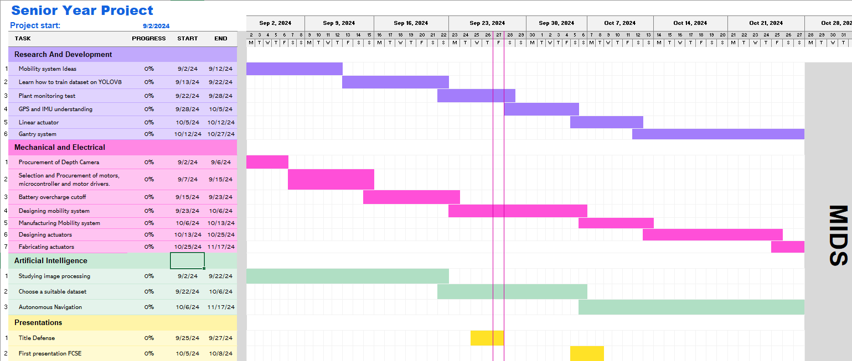
Gantt Chart:

Slide 13
Any Questions?

Slide 14
Thank You

